Slide 1
Lecture 2
Early Concepts: Chicago School of Sociology and Classical Models of Economic Geography
2.2 “The City” and Urbanism as a Way of Life
©Luís M. A. Bettencourt 2024
IUS Chapter 2.2
Notes:
This module goes over some important historical perspectives and methods, especially from the point of view of Chicago. The maps are worth seeing though and the lessons about data are important.

Slide 2
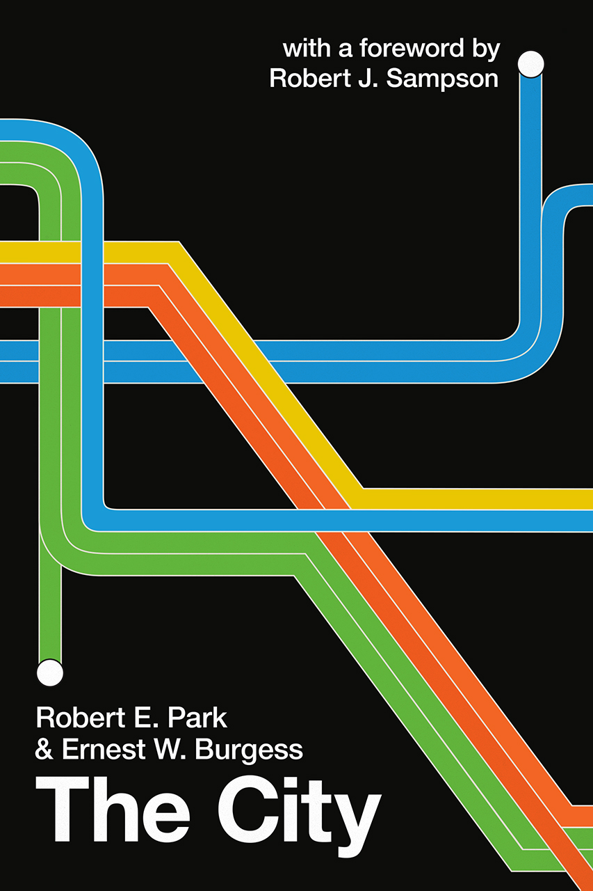
1925
Optional reading: Chapter 1
Suggestions for Investigation of Human Behavior in the Urban Environment
Notes:
Back to the Chicago School of “Urban Ecology”

Slide 3
CHAPTER I
THE CITY: SUGGESTIONS FOR THE INVESTIGATION
OF HUMAN BEHAVIOR IN THE URBAN ENVIRONMENT
Robert E Park
Optional Reading
The city […] is something more than a congeries of individuals and of social conveniences— streets, buildings, electric lights, tramways, and telephones, etc.;
Something more, also, than a mere constellation of institutions and administrative devices-courts, hospitals, schools, police, and civil functionaries of various sorts.
The city is, rather, a state of mind, a body of customs and traditions, and of the organized attitudes and sentiments that inherit in these customs and are transmitted with this tradition.
The city is not, in other words, merely a physical mechanism and an artificial construction. It is involved in the vital processes of the people who compose it;
It is a product of nature, and particularly of human nature.

Slide 4
The City sets a Research Agenda
113(?) Questions:
please count them better
First set of Questions [“some of the first things we want to know about a city”]:
- What are the sources of the city's population?
- What part of its population growth is normal, i.e., due to excess of births over deaths?
- What part is due to migration (a) of native stocks? (b) foreign stocks?
- What are the outstanding “natural" areas, i.e., areas of population segregation?
- How is the distribution of population within the city area affected by (a) economic Interest, i.e., land values? (b) by sentimental interest, race? vocation etc.?

Slide 5
The City: Emphasis on cognition and social behavior
“The Stock Exchanges and the Mob”:
Urban cognition
- What is the psychology of crisis? What is the cycle of events involved in the evolution of a crisis, political or economic?
- To what extent may the parliamentary system, including the electoral system, be regarded as an attempt to regularize revolution and to meet and control crises ?
To what extent are mob violence, strikes, and radical political movements the results of the same general conditions that provoke financial panics, real estate booms, and mass movements in the population generally?
- To what extent are the existing unstable equilibrium and social ferment due to the extent and speed of economic changes as reflected in the stock exchange?
What are the effects of the extension of communication and of news upon fluctuatIons In the stock market and economic changes generally ?
Do the reports in the newspapers, so far as they represent the facts tend to speed up social changes, or to stabilize a movement already in progress?
What is the effect of propaganda and rumor, in cases where the sources of accurate information are cut off?
- To what extent can the city, which responds more quickly and more decisively to changing events, be regarded as nerve centers of the social organism?
Notes:
Many good questions …

Slide 6
Urbanism as a way of life
Louis Wirth
University of Chicago School of Sociology
1938
Notes:
This is the famous paper by Louis Wirth, Note that he is trying to come up with a theory of urbanism, and as such needs to describe it as a process; a way things work in general.

Slide 7
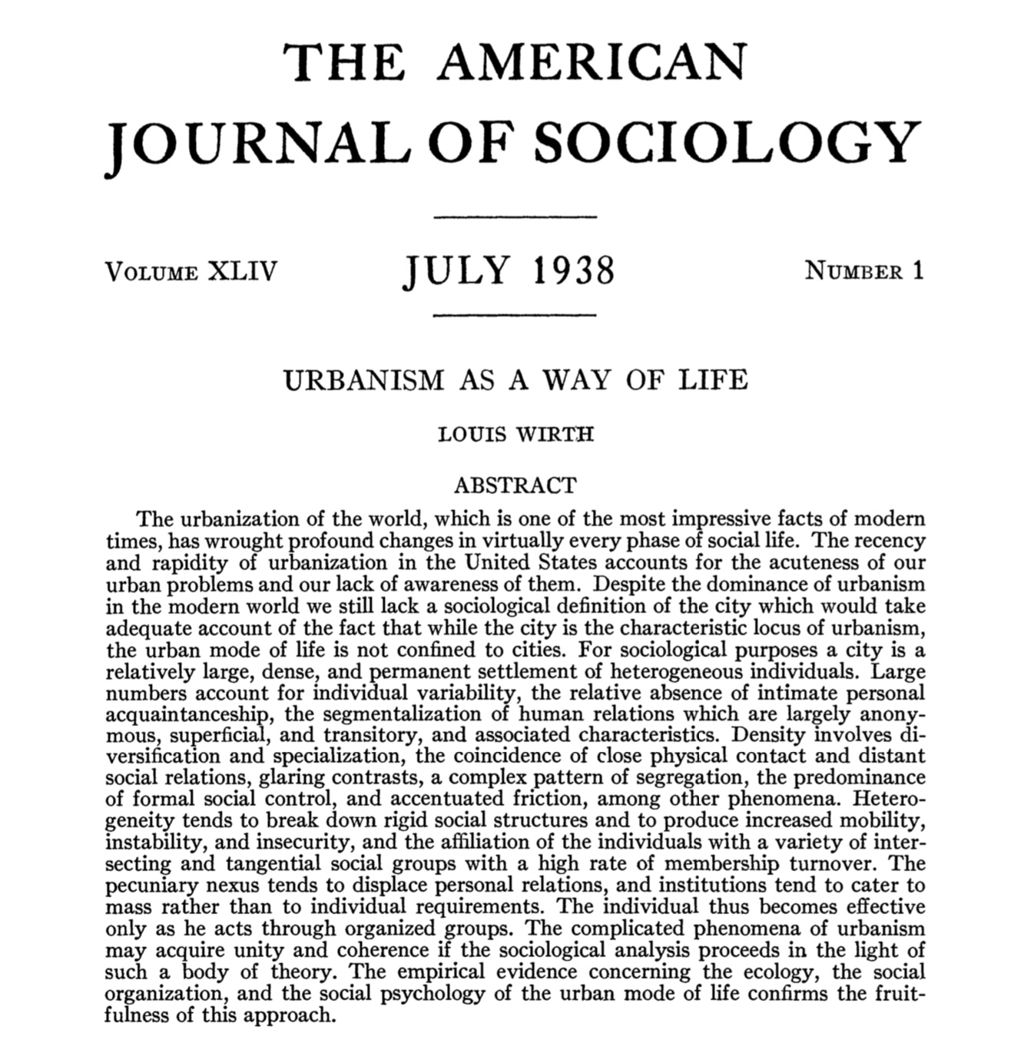
One of the greatest papers ever about cities !!
Optional reading

Slide 8
The search for a (first) Theory of Urbanism
A sociological significant definition of a city seeks to select those elements that of urbanism which mark it as a distinctive mode of human group life:
A city may be defined as a relatively large, dense and permanent settlement of socially heterogeneous individuals.
Continuity: The larger, the more densely populated, and the more heterogeneous a community, the more accentuated the characteristics associated with urbanism will be.
Theory: essential characteristics of every city versus variations between cities (and people)
Number of propositions concerning the relationship between:
a) numbers of population, b) density of settlement, c) heterogeneity of settlement and group life
Sociology: differentiation and multiplication of roles, diversity
independence of personal characteristics, protection from expectations of others
segregation and tolerance, sophistication and cosmopolitanism
anomie
Economics: segmentation of social life; division of labor. Organizations: corporations, markets and signals.
Innovation: premium upon eccentricity, novelty, efficient performance, inventiveness
- interactions, rapid tempo, complicated technology
Psychology: no conception of the city as a whole, no place in the total scheme, unpredictability, mobility, change
Political Science: emergence of collective causes, mass movements, political organizations
information
scaling
Consequences
Interdisciplinary
multiscalar
“evolutionary”
dynamics
draws widely: Aristotle, Weber, Simmel, Marx, Smith, Park, Durkheim, Darwin,…

Slide 9
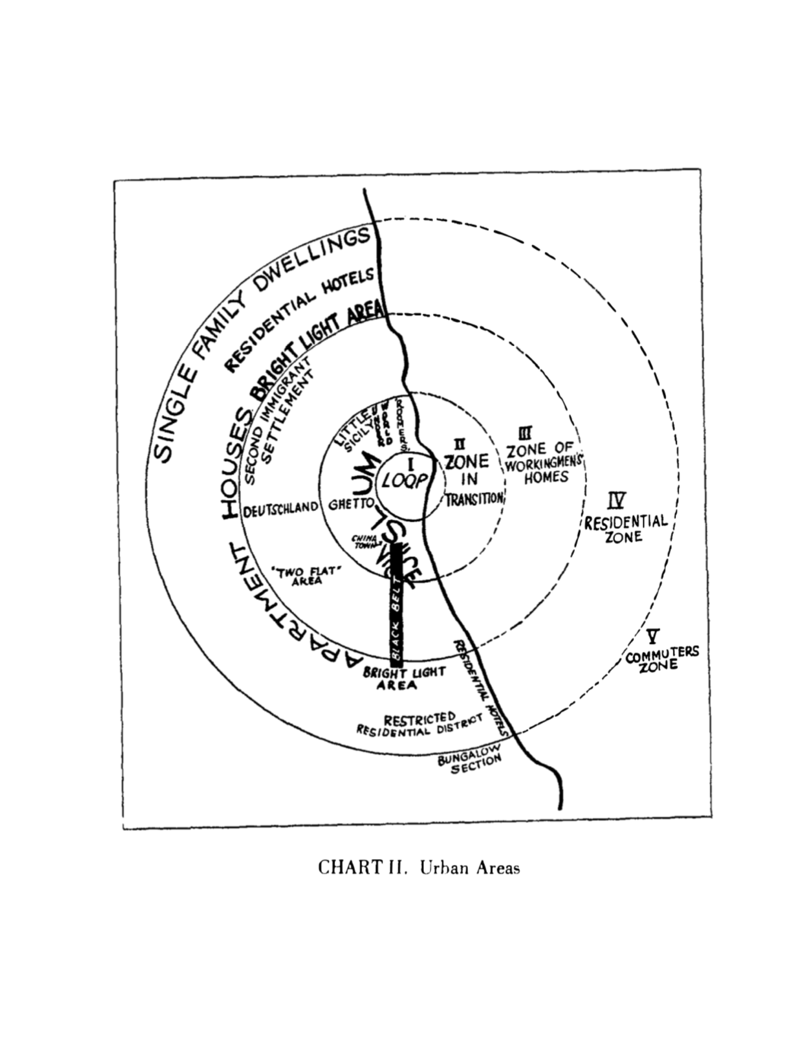
Chicago
This paper will treat first of the expansion of the city, and then of the less-known processes of urban metabolism and mobility which are closely related to expansion.
The metropolitan area may be taken to include territory that is physically contiguous, but it is coming to be defined by that facility of transportation that enables a business man to live in a suburb of Chicago and to work in the loop.
The tendency of each inner zone to extend its area by the invasion of the next outer zone. This aspect of expansion may be called succession
Besides extension and succession, the general process of expan­sion in urban growth involves the antagonistic and yet comple­mentary processes of concentration and decentralization
This differentiation into natural economic and cultural group­ings gives form and character to the city
The division of labor in the city likewise illustrates disorganiza­tion, reorganization, and increasing differentiation, movement and mobility
Ernest W Burgess 1925
Notes:
This is the famous map pf Chicago by Burgess that introduced to urbanisms the concentric ring concept, we will see where this comes from in a moment. But note how “land uses” and urban functions, along with ethnicities and races, and socioeconomic status are assumed (somewhat wrongly) to be separated.

Slide 10
“Big Data”
(of its time)
Notes:
Big data has been a feature of cities at least for a century…

Slide 11
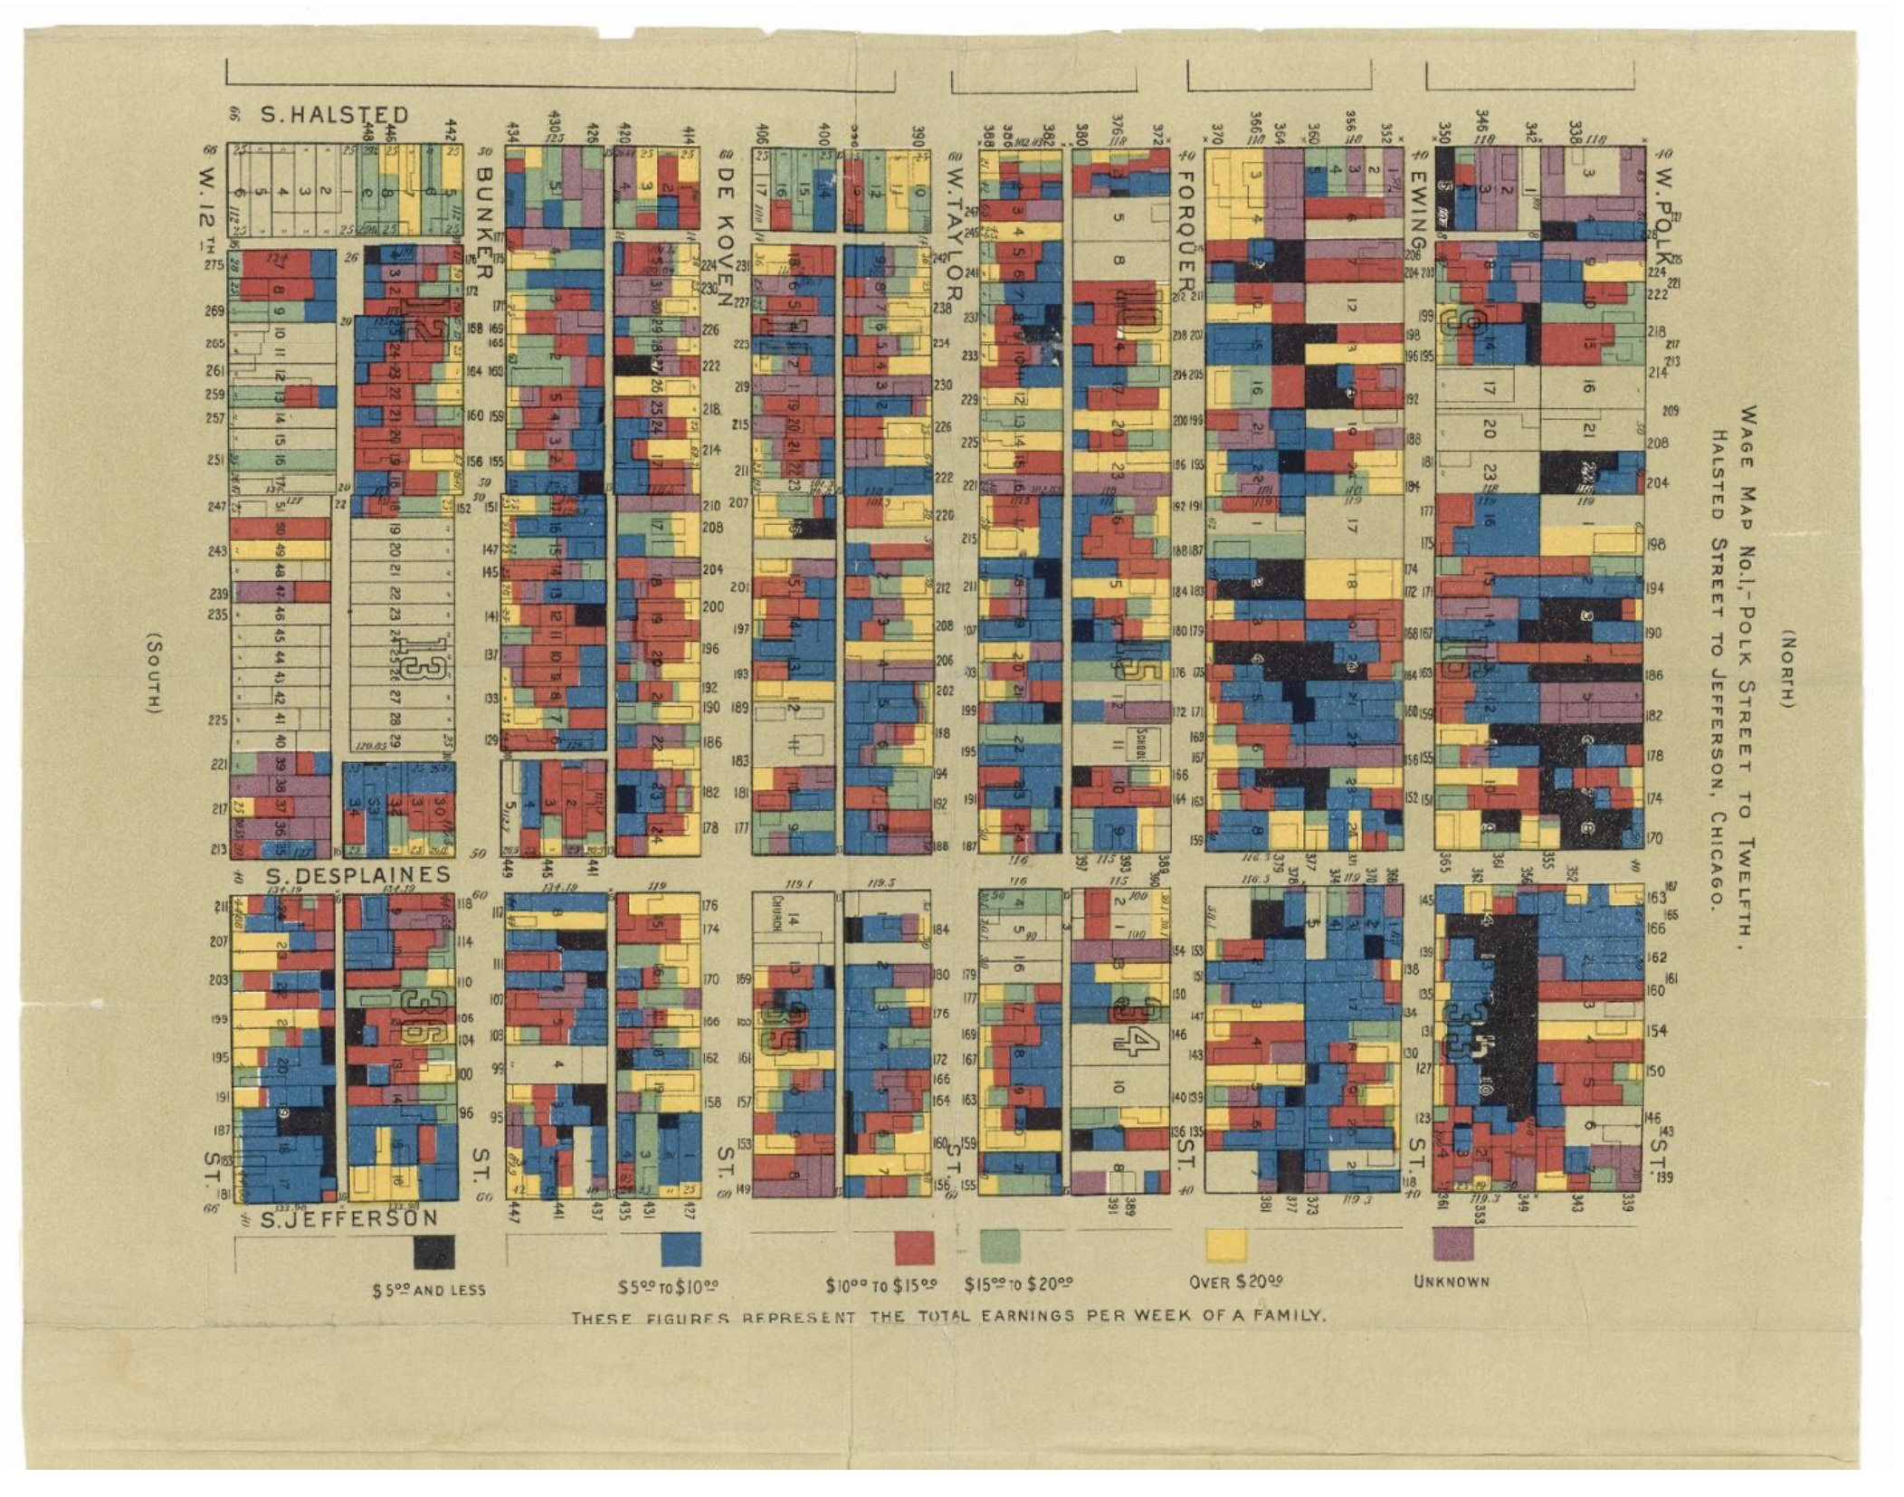
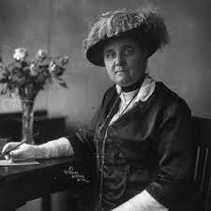
“for their assiduous effort to revive the ideal of peace and to rekindle the spirit of peace in their own nation and in the whole of mankind”
Jane Addams
Nobel Prize 1931
Hull-House Maps and Papers , 1895
http://www.encyclopedia.chicagohistory.org/pages/410008.html
C. F. Charles Booth’s Maps of Poverty in London,
Notes:
Famous Hull House maps of poverty (each household) !

Slide 12
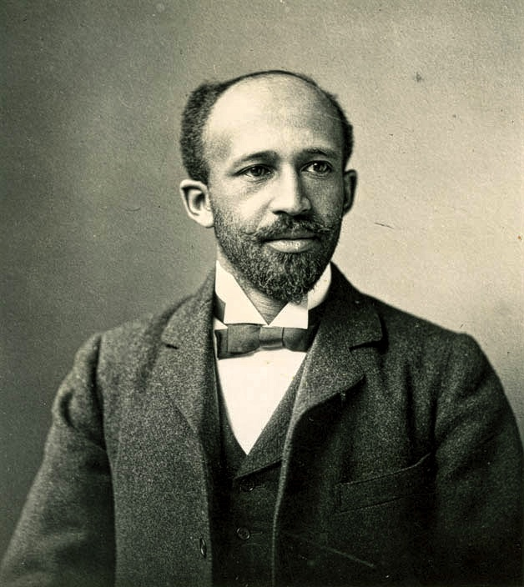
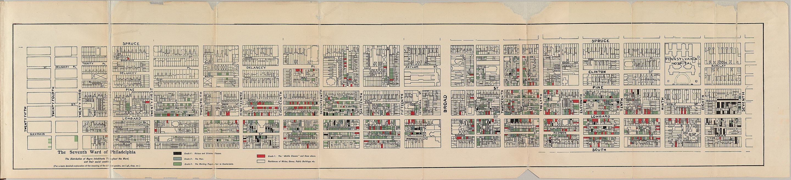
“not one problem, but rather a plexus of social problems,”
"the Negro problem […] is but the old world questions of ignorance, poverty, crime, and the dislike of the stranger."
W. E. B. DuBois, The Philadelphia Negro 1899
http://stillfamily.library.temple.edu/exhibits/show/william-still/maps/w-e-b--du-bois-seventh-ward-ma
Notes:
Earlier maps of race and income in Philadelphia. WEB Dubois wants to use this data to destroy prejudiced and lazy associations between race and income, and reveal the systemic nature of real life.

Slide 13
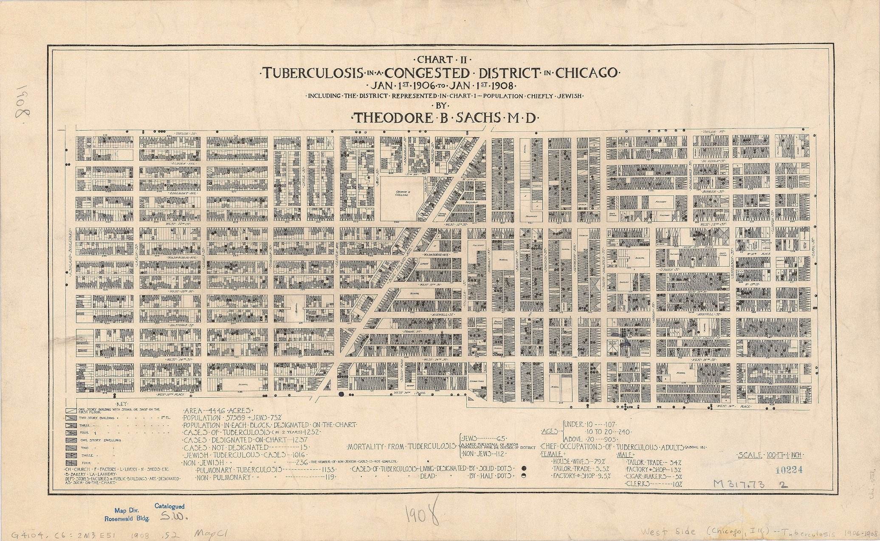
Notes:
This sort of thing was then systematized in Chicago and took many forms, mostly of detailed maps.

Slide 14
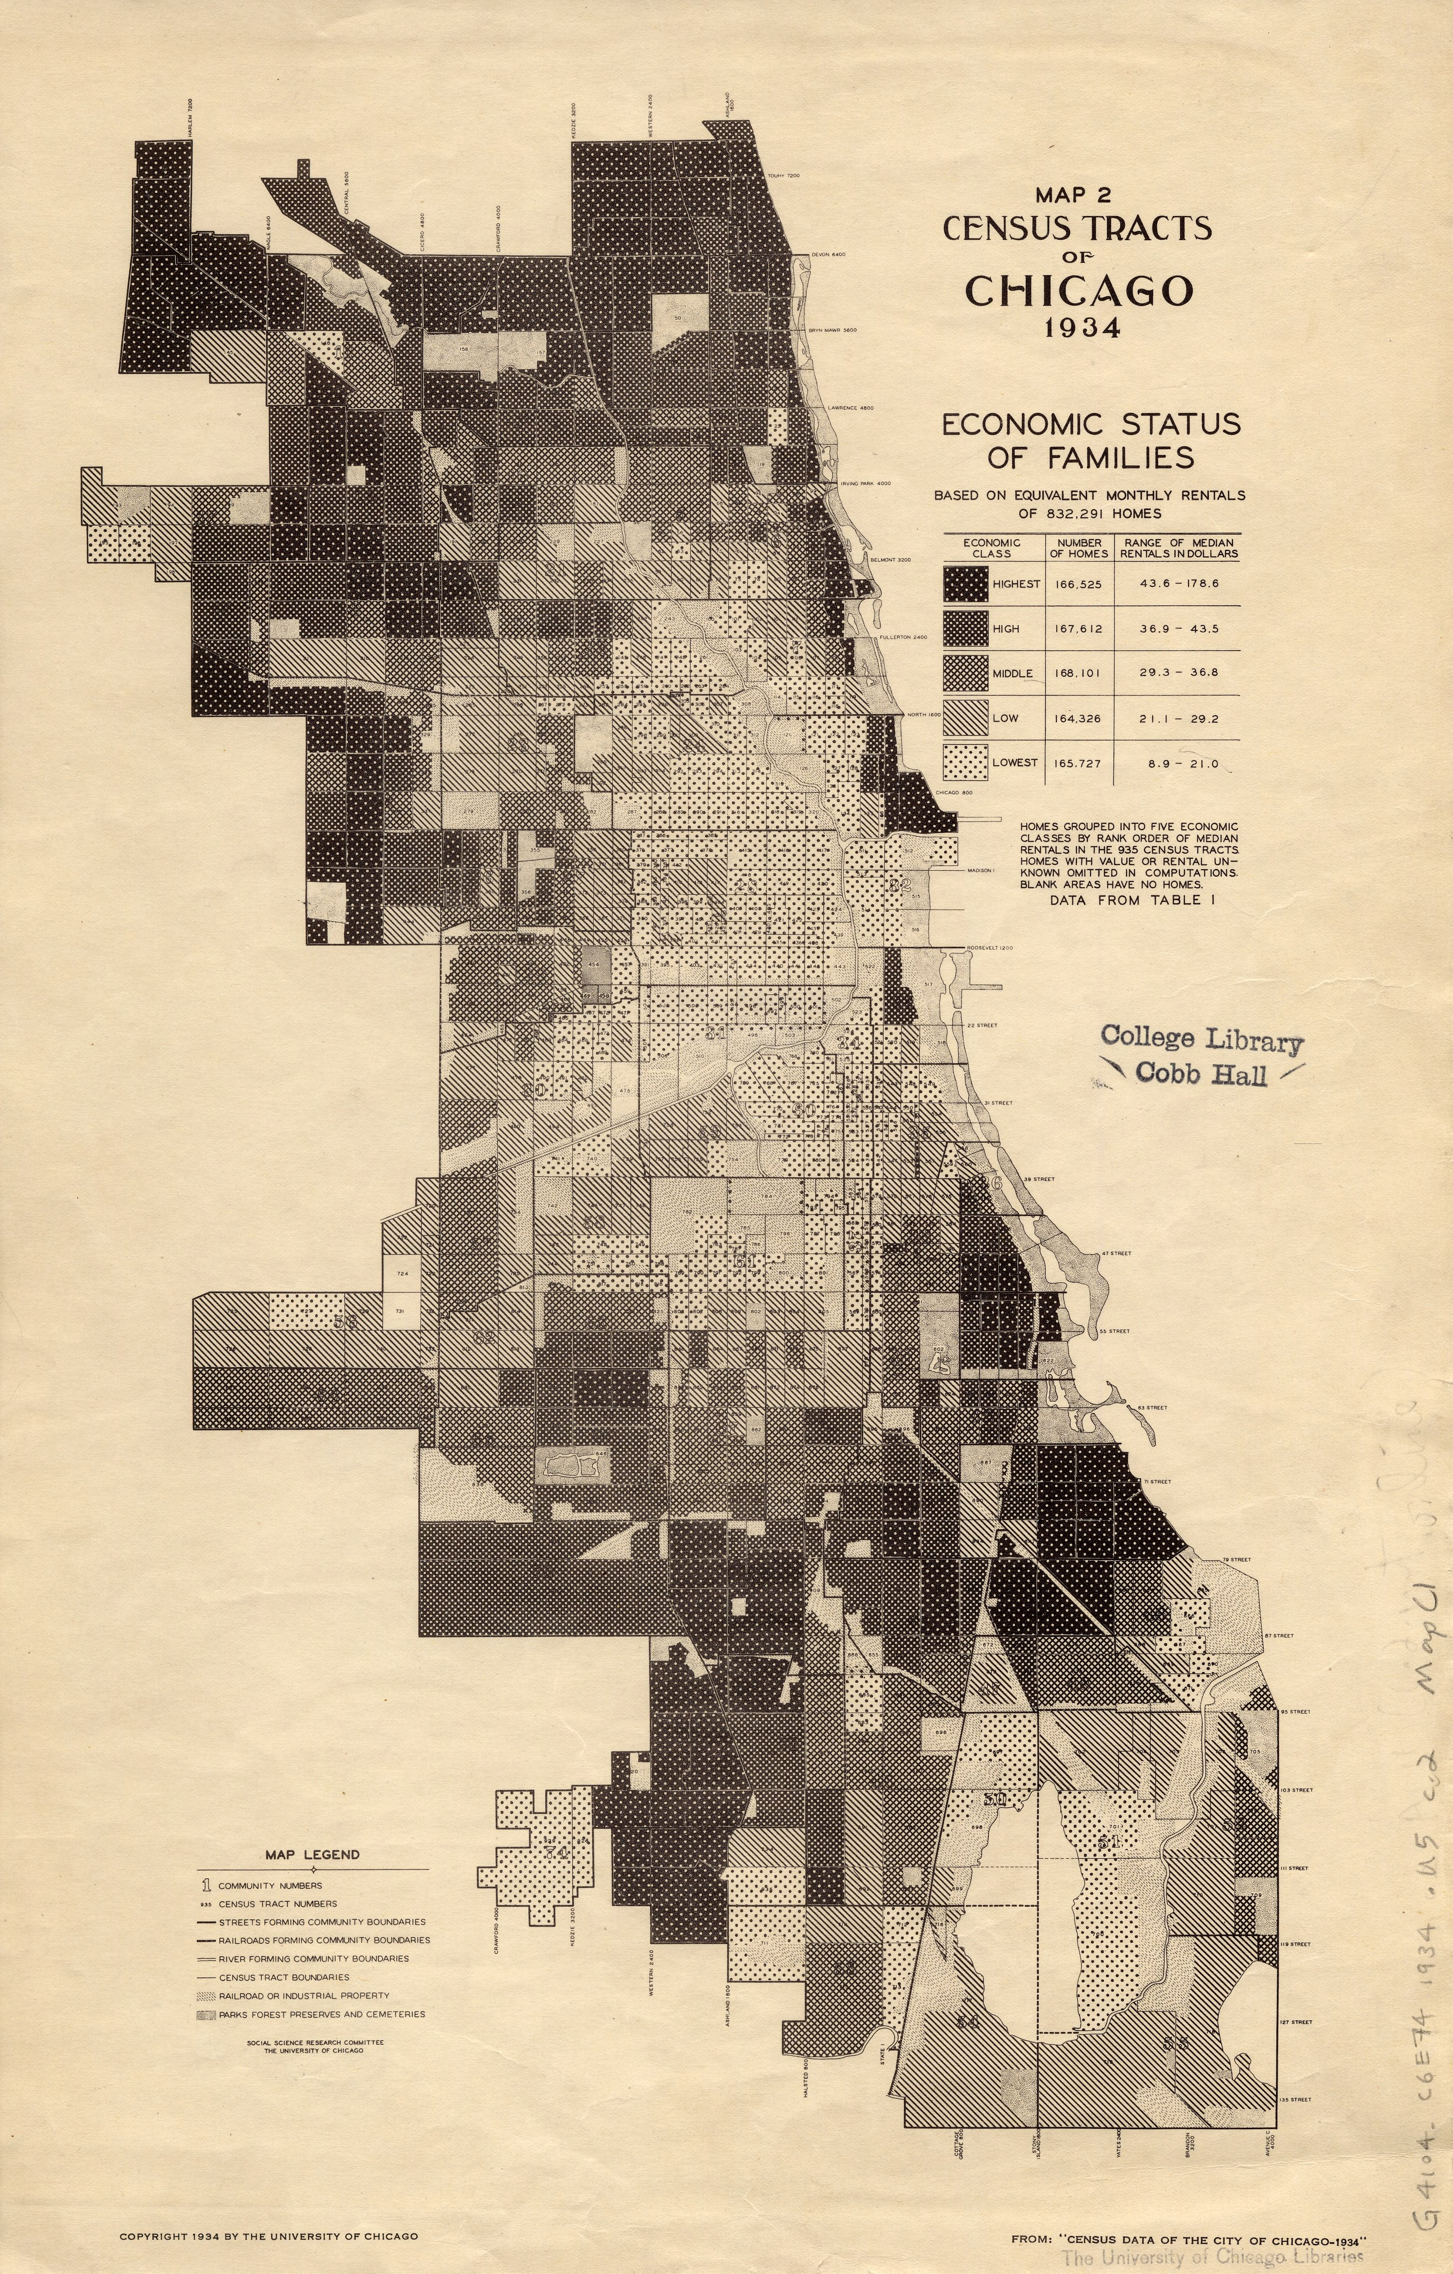
Chicago School of Sociology: Maps of the City
“Olympian Vantage Point”
“Data driven” approach to Cities
in the early 20th century”
Hyde Park
Go to UChicago’s Library and ask for Cecilia Smith
Notes:
Hyde Park is the University of Chicago’s neighborhood. It is quite atypical as it is richer and more mixed than other neighborhoods around it.

Slide 15
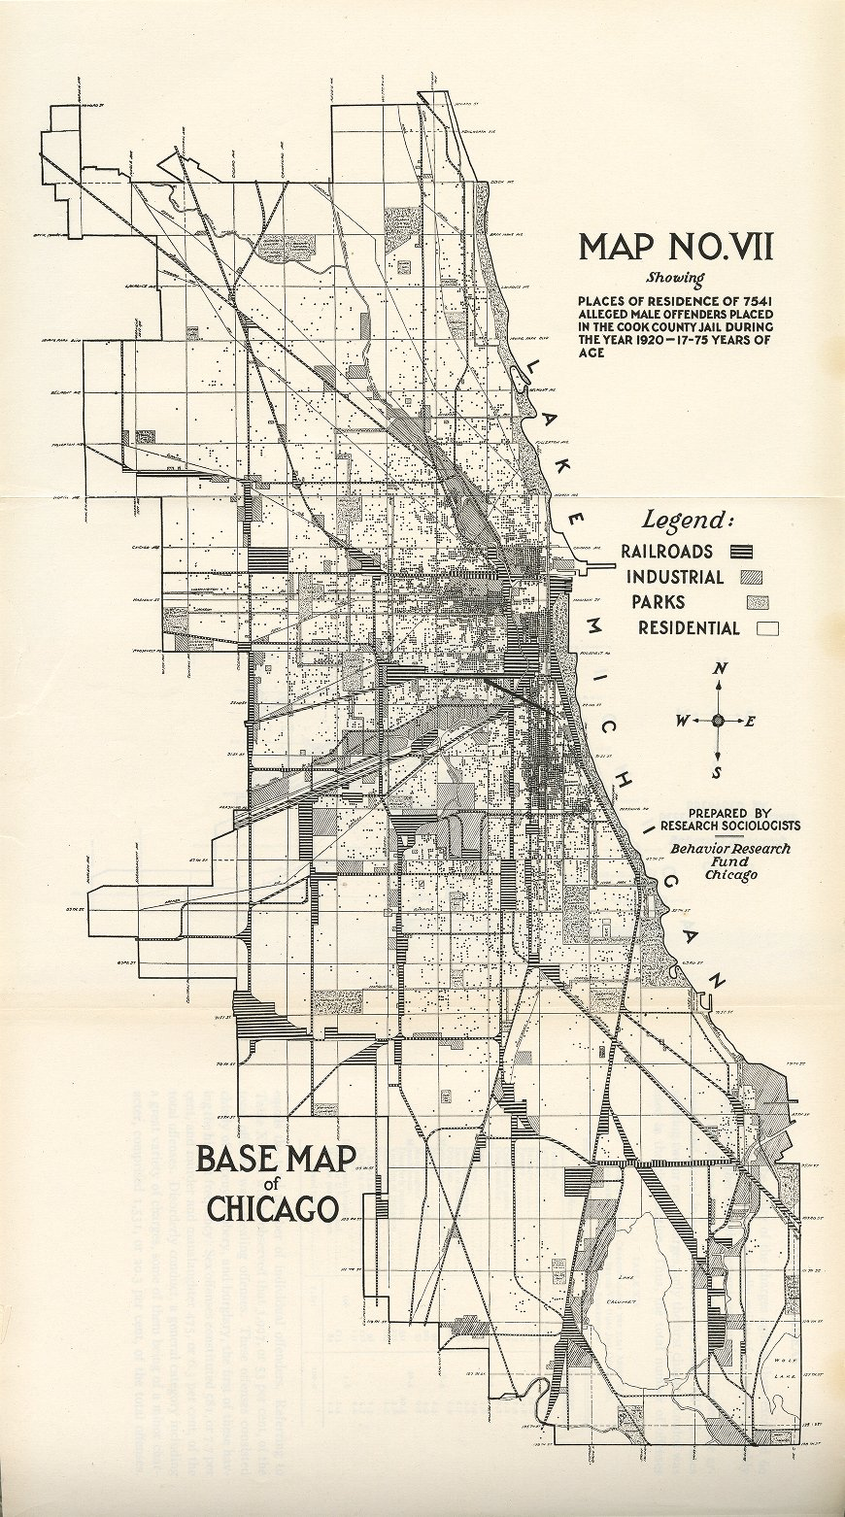
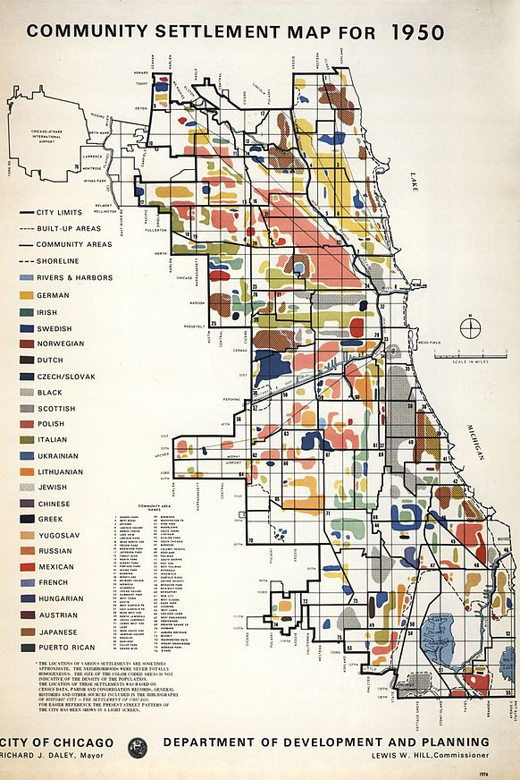

Slide 16
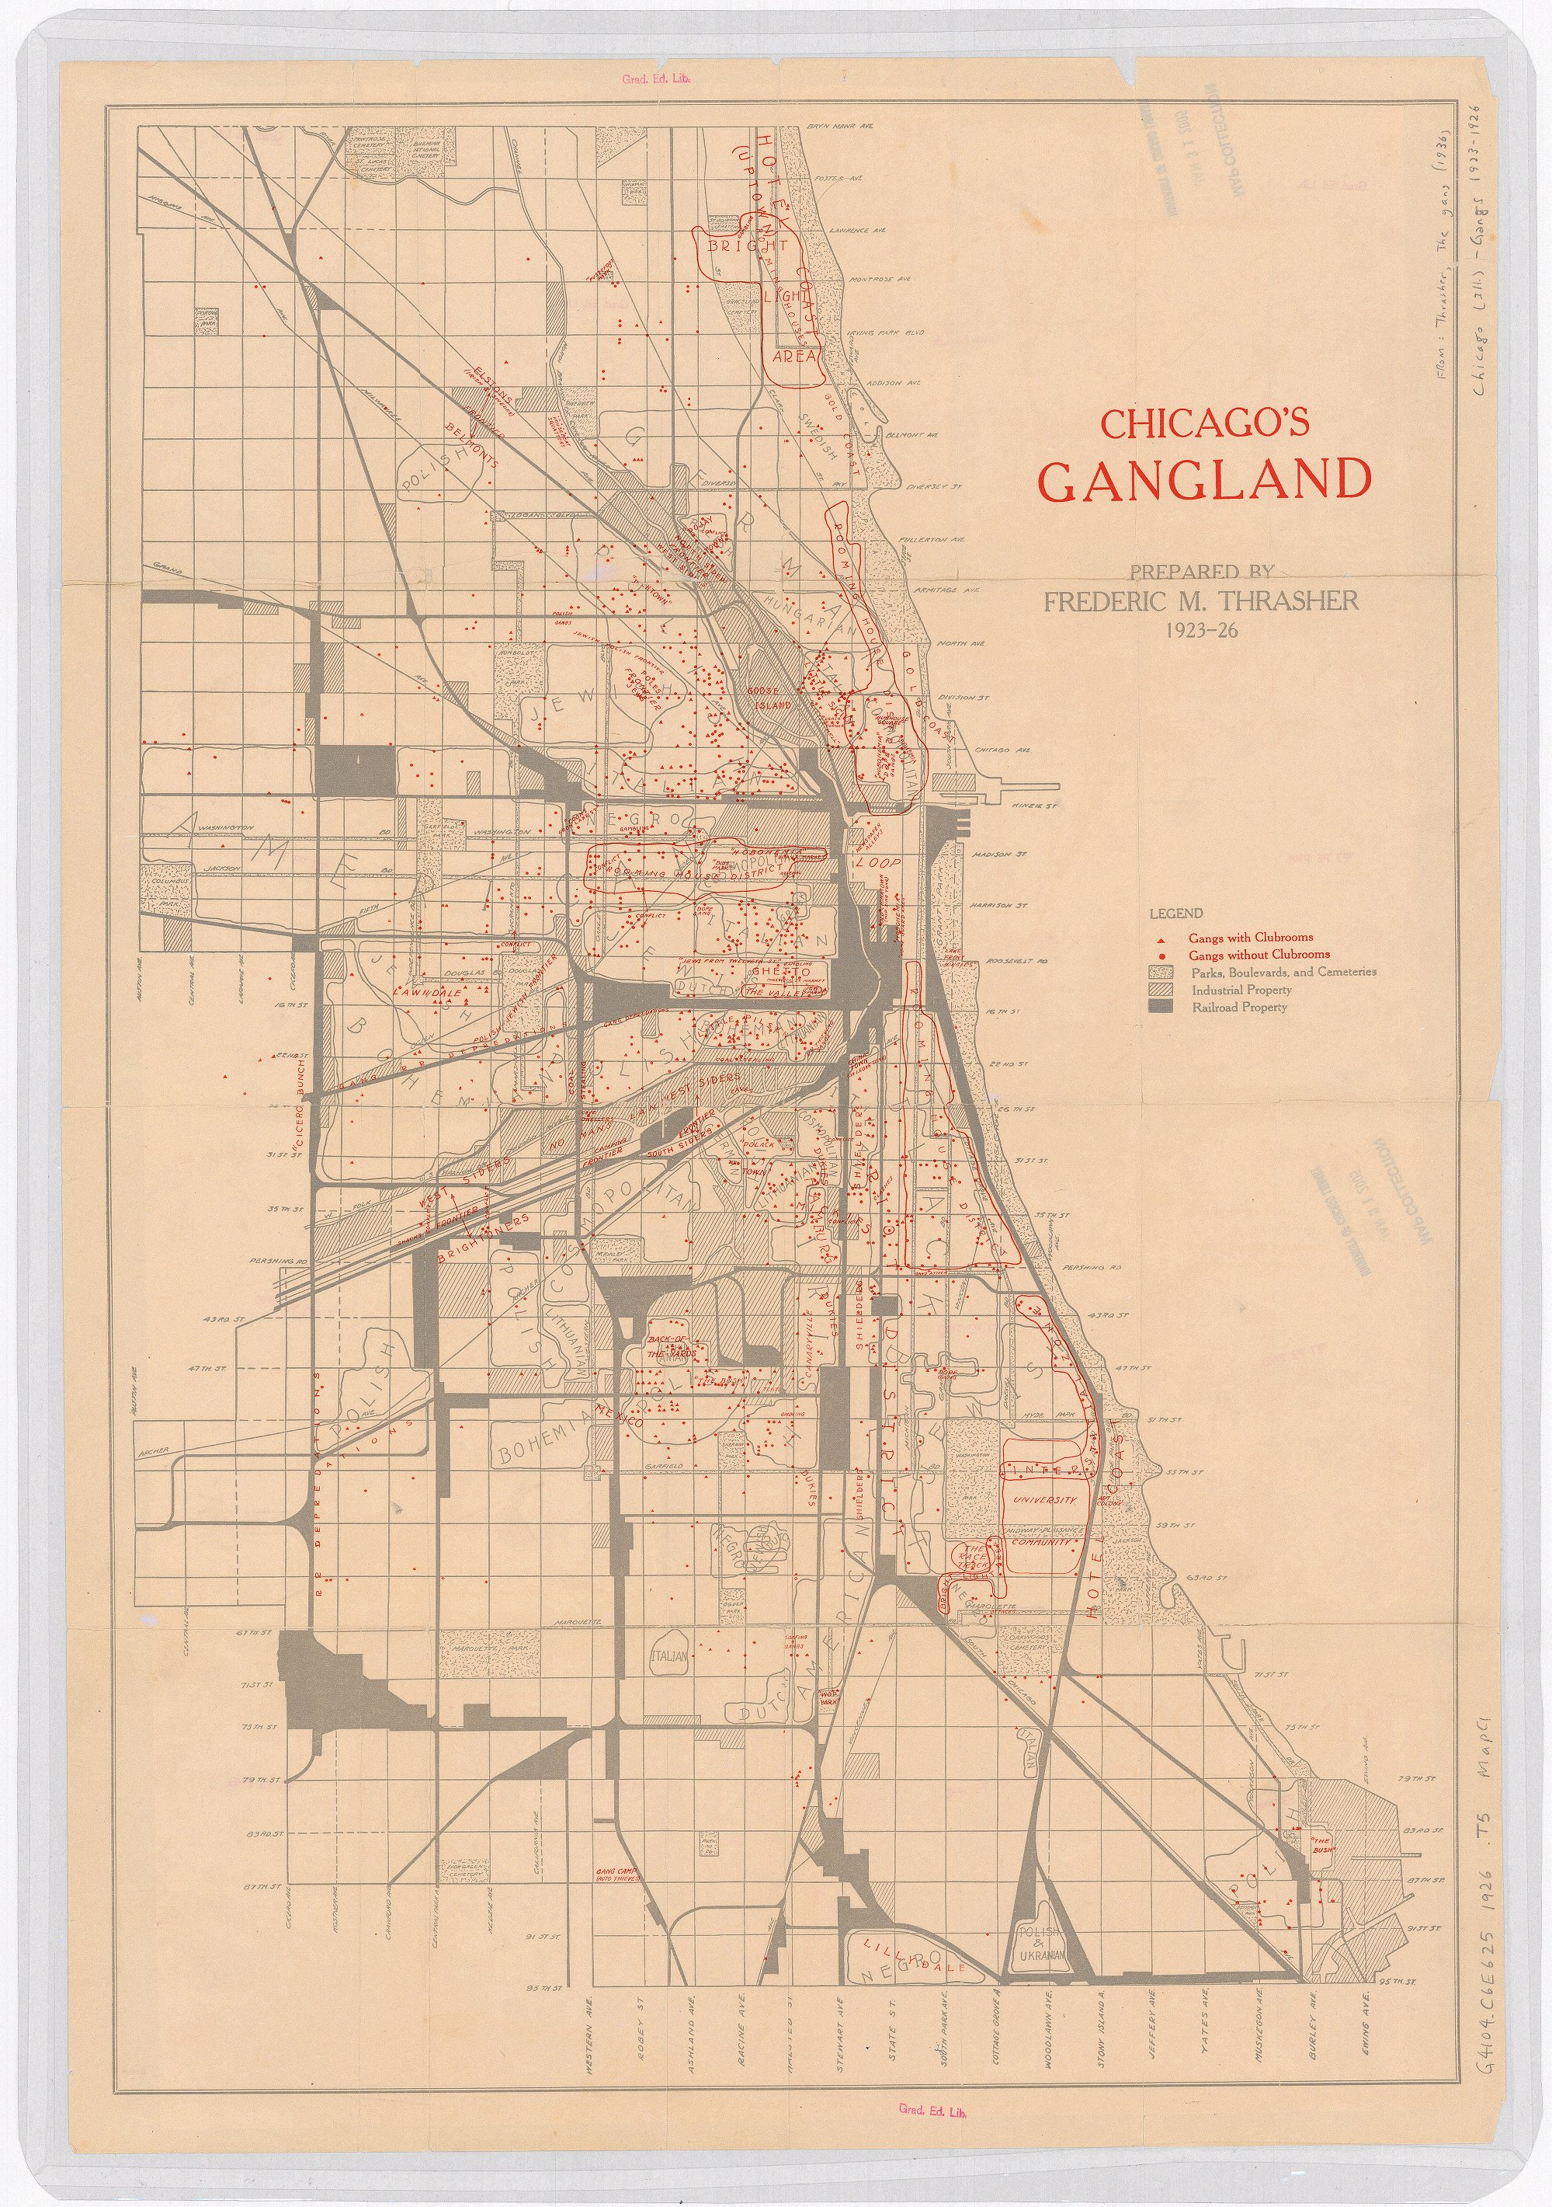
We will return to these maps for studies of “Neighborhood Effects”
55th street

Slide 17
The first Chicago School of Urban Sociology established many of the questions and methods we still use and need to address
It started the field of “urban science” and has had widespread influence on how cities are conceived and studied
It also showed the limited effect of data on good policy from a human and social perspective
Notes:
The fact that all this data has not arguably had more and better impact in practical progress is something worth discussing, why not? What else is missing?

